Slide 1
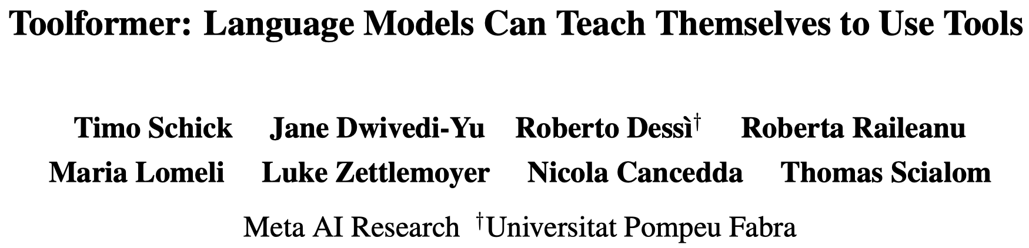

Slide 2
Background
Language Models Limitations
access up-to-date information on recent events
the related tendency to hallucinate facts
difficulties in understanding low-resource languages
a lack of mathematical skills to perform precise calculations
an unawareness of the progression of time
Existing approaches:
(supervised finetuning) rely on large amounts of human annotations
(in-context learning) limit tool use to task-specific settings only
In this paper:
self-supervised way to generate annotations
not lose LM’s generality
LMs decide when and how to use which tool

Slide 3
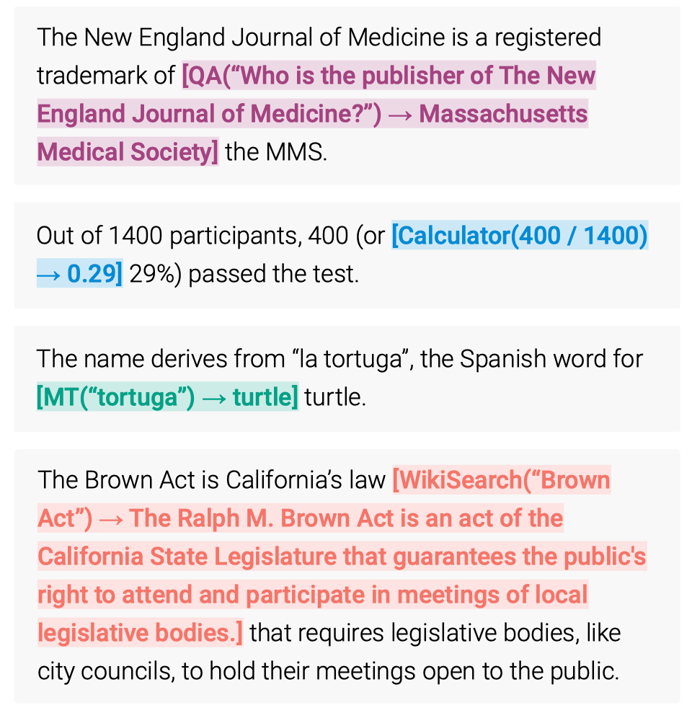
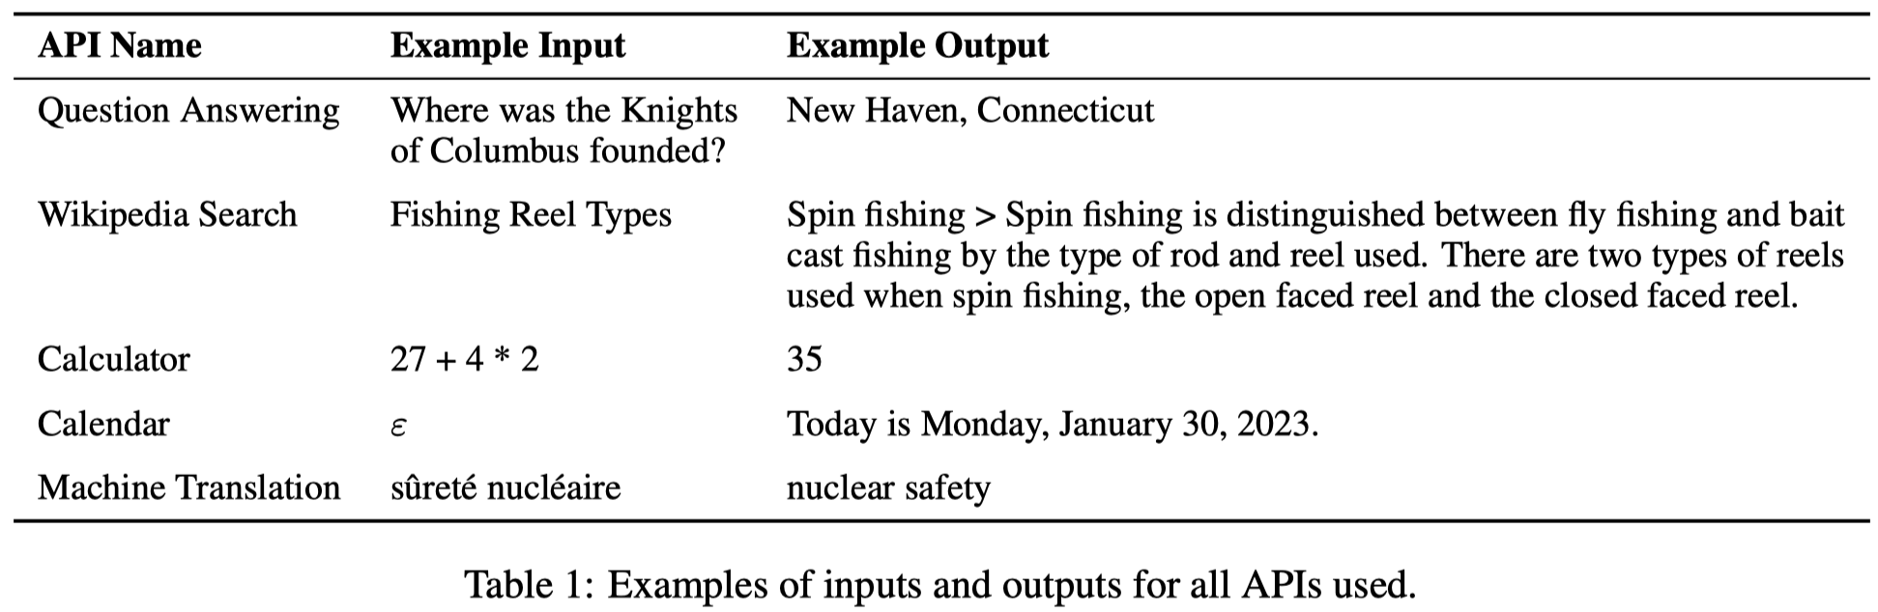
Tools
Atlas-xxl 11B
BM25
NLLB 600M

Slide 4
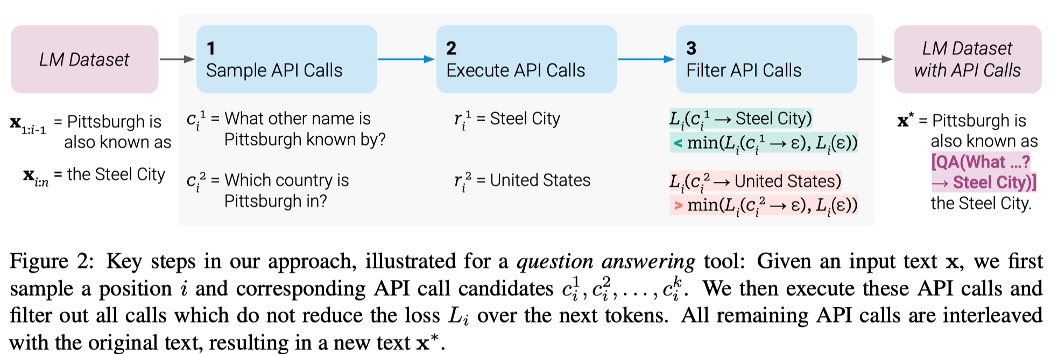
Method
Construct a annotated dataset from a general purpose dataset with a self-supervised way
Fine-tune the model with this new dataset
Inference with API Call

Slide 5

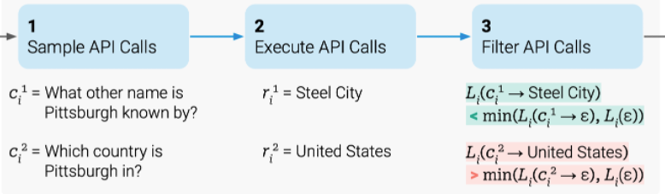
Dataset Construction
Which position to call the API
In-context learning
What type of API and what to input
In-context learning
simple heuristic filtering
What kind of API call is helpful for LMs
Filtering with generation loss

Slide 6
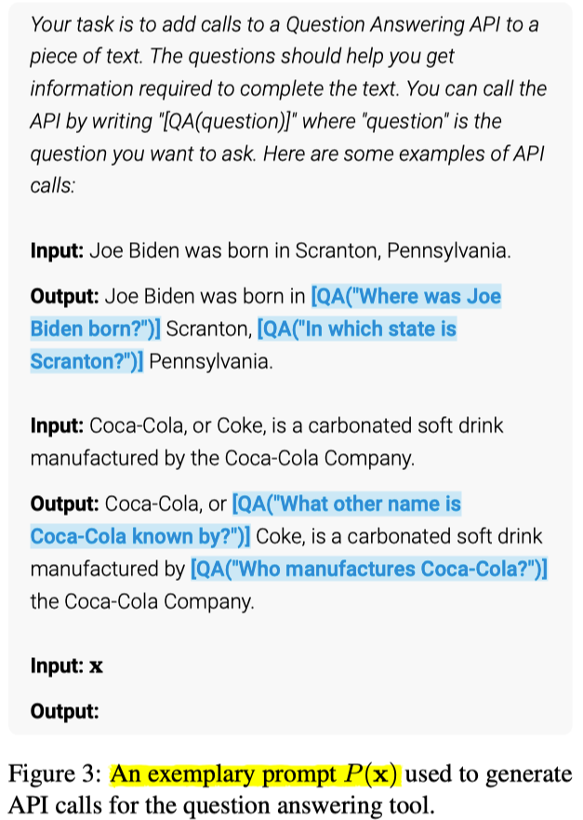

Sample API Calls
position and input
keep top-5 positions in each sample
sample up to 5 API call inputs
type
calculator:
3 number in 100 tokens
“=”, “equals”, “equal to”, “total of”, “average of” followed by a number
contain at least three numbers
MT:
contain text chunks in a language other than English preceded and followed by English text
> 0.05

Slide 7
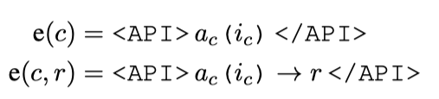
Execute API Calls
Atlas-xxl 11B
BM25
NLLB 600M
In practice, we use the token sequences “ [”, “]” and “->” to represent “<API>”, “</API>” and “→”, respectively.
Notes:
This enables our approach to work without modifying the existing LM’s vocabulary. For reasons of readability, we still refer to them as “<API>”, “</API>” and “→” throughout this section.

Slide 8
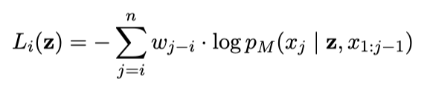

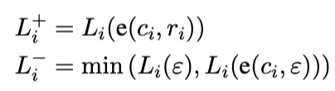

Filter API Calls
5-gram
Calculate(1+2)->3 Tom has an apple, Bob has 2 apples. They have 3 apples in total.
Tom has an apple, Bob has 2 apples. They have 3 apples in total.
Calculate(1+2) Tom has an apple, Bob has 2 apples. They have 3 apples in total.
= 1.0
We provide e(c_i, r_i) as a prefix instead of inserting it at position i because M is not yet finetuned on any examples containing API calls, so inserting it in the middle of x would interrupt the flow and not align with patterns in the pretraining corpus, thus hurting perplexity.

Slide 9
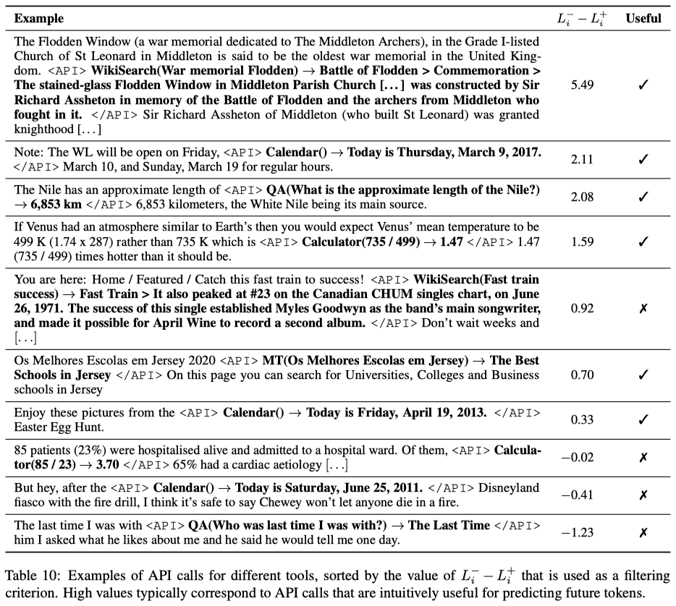

Slide 10
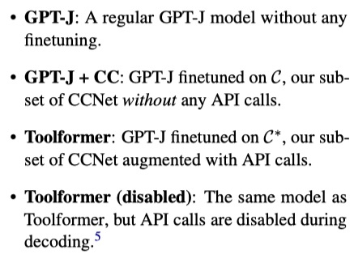
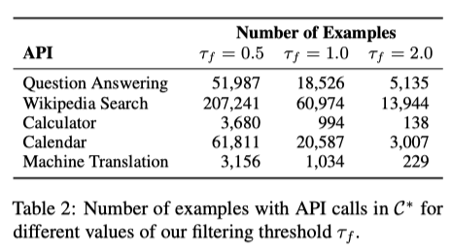
Training
init with GPT-J 6B
Corpus:
a subset of CCNet
use up to 25k examples per API.

Slide 11
Inference
We perform regular decoding until M produces the “→” token.
We continue the decoding process after inserting both the response and the </API> token.
greedy decoding except for <API>
whenever it is one of the k most likely tokens. (k = 10)
At most one API call per input
Notes:
We note that while at training time we score each training example independently, at test time the language model observes a prompt, i.e., a sequence of examples. We leave modeling the dependence between different training examples to future work

Slide 12
Experiment
Downstream tasks (zero-shot)
LAMA (language model analysis)
Math Datasets
Question Answering
Multilingual Question Answering
Temporal Datasets
Language modeling
Scaling Laws
Ablation: k for <API> token

Slide 13
Experiment (zero-shot)
LAMA (language model analysis)
SQuAD, GoogleRE and T-Rex subset
complete a short statement with a missing fact (e.g., a date or a place).
check whether the correct word is within the first 5 words predicted by the model
disable the Wikipedia Search API
Math Datasets
ASDiv, SVAMP and MAWPS
check for the first predicted number
Question Answering
Web Questions, Natural Questions and TriviaQA
check whether the correct word is within the first 20 words predicted by the model
disable the question answering tool
Multilingual Question Answering
MLQA: the context is in English and the questions is in other languages
check whether the correct word is within the first 10 words predicted by the model
Temporal Datasets
TEMPLAMA and a new dataset

Slide 14
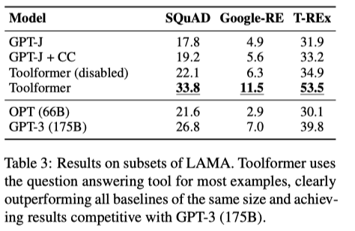
LAMA
LAMA (language model analysis)
SQuAD, GoogleRE and T-Rex subset
complete a short statement with a missing fact (e.g., a date or a place).
check whether the correct word is within the first 5 words predicted by the model
disable the Wikipedia Search API
98.1% question answering tool
0.7% other tools
1.2% no tool

Slide 15
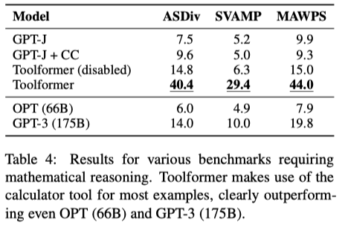
Math
Math Datasets
ASDiv, SVAMP and MAWPS
check for the first predicted number
97.9% calculator tool

Slide 16
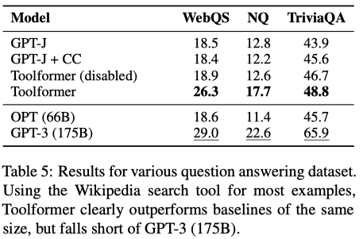
QA
Question Answering
Web Questions, Natural Questions and TriviaQA
check whether the correct word is within the first 20 words predicted by the model
disable the question answering tool
99.3% Wikipedia search API

Slide 17
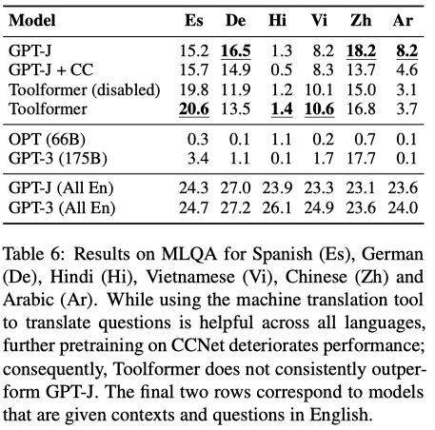
Multilingual
Multilingual Question Answering
MLQA: the context is in English and the questions is in other languages
check whether the correct word is within the first 10 words predicted by the model
63.8% to 94.9% machine translation tool for different languages
only 7.3% for Hindi

Slide 18
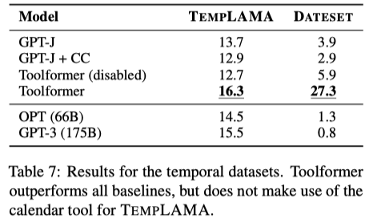
Multilingual
Temporal Datasets
TEMPLAMA and a new dataset
Cristiano Ronaldo plays for the years between 2010 and 2020.
What day of the week was it 30 days ago?
mostly to the Wikipedia search and question answering tools
54.8% calendar tool

Slide 19
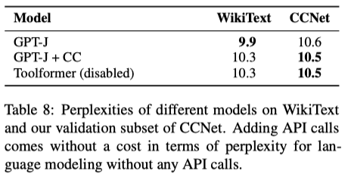
Language Modeling
Language Modeling
WikiText
a subset of 10,000 randomly selected documents from CCNet that were not used during training

Slide 20
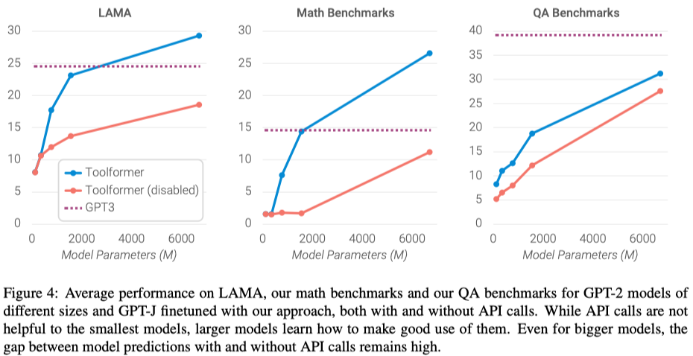
Scaling Laws
GPT-J
6B
GPT2
124M
355M
775M
1.6B

Slide 21
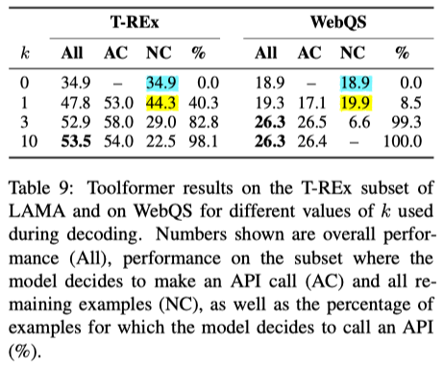
Ablation: k
Increasing k leads to the model doing API calls for more examples.
For T-REX, there is already a clear improvement in performance with k=1.
For WebQS the model only starts to make a substantial number of API calls as we slightly increase k.
For k = 1, the model can decide to call APIs for examples that it would perform particularly badly on without making API calls.

Slide 22
Inference
We perform regular decoding until M produces the “→” token.
We continue the decoding process after inserting both the response and the </API> token.
greedy decoding except for <API>
whenever it is one of the k most likely tokens. (k = 10)
At most one API call per input
Notes:
We note that while at training time we score each training example independently, at test time the language model observes a prompt, i.e., a sequence of examples. We leave modeling the dependence between different training examples to future work

Slide 23
Conclusion
A new framework to incorporate knowledge into LMs.
two-stage retrieval approach
retrieval result as prefix
retrieval->finetuning
retrieval->in-context learning

